Slide 1
EE 441 Data Structures
Lecture 8: Trees

Slide 2
Trees
Linear lists, structures:
Arrays, stacks, queues, linked lists
Unique first and last element, each element has a unique successor
Non-linear structures:
A member might have multiple successors
Trees:
Nodes and branches
Flow from root to leaves (outer nodes)

Slide 3
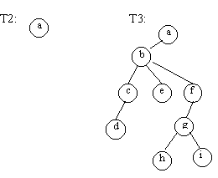
Trees
A tree is a set of nodes:
It can be a null tree without any nodes
one node designated as the root and the remaining nodes partitioned into smaller trees, called sub-trees.
Example:
T1={} (NULL Tree)
T2={a} a is the root, the rest is T1
T3={a, {b,{c,{d}},{e},{f,{g,{h},{i}}}}

Slide 4
Trees
The level of a node is the length of the path from the root to that node
The depth of a tree is the maximum level of any node in the tree
The degree of a node is the number of partitions in the subtree which has that node as the root
Nodes with degree=0 are called leaves
Level 0
Level 1
Level 2
Level 3
Depth= 3

Slide 5
Binary Trees
A tree in which the maximum degree of any node is 2.
Uniform structure: Efficient scan and search
A binary tree may contain up to 2^{n} nodes at level n.
depth=3
depth=2

Slide 6
Binary Trees
A complete binary tree of depth N has 2^{k} nodes at levels k=0,…,N-1 and all leaf nodes at level N occupy leftmost positions.
If level N has 2^{N} nodes as well, then the complete binary tree is a full tree.
If all nodes have degree=1, the tree is a degenerate tree (or simply linked list)
Complete tree, depth=3
Full tree, depth=2
Degenerate tree,
depth=2

Slide 7
Examples: Binary Trees
a degenerate tree of depth 5 has 6 nodes
a full tree of depth 3 has 1+2+4+8=15 nodes
a full tree of depth N has 2^{N+1}-1 nodes
a complete tree of depth N has 2^{N}≤m≤2^{N+1}-1<2^{N+1} nodes
Depth of a complete tree with m nodes: k≤log₂m≤k+1
The maximum depth in a tree with 5 nodes is 4: degenerate
The minimum depth in a tree with 5 nodes is 2: complete
int(log₂5)=int(2.32)=2

Slide 8
Binary Trees: Data structure
left
A
right
A
left
B
right
left
C
right
B
C
D
E
F
left
D
right
left
E
right
left
F
right

Slide 9
Tree Node
template <class T>
class TreeNode
{private:
TreeNode<T> *left;
TreeNode<T> *right;
public:
T data;
//constructor
TreeNode(const T &item, TreeNode<T> *lptr=NULL, TreeNode<T>
*rptr=NULL);
//access methods for the pointer fields
TreeNode<T>* Left(void) const;
TreeNode<T>* Right(void) const;
};
//constructor
template <class T>
TreeNode<T>:: TreeNode(const T &item, TreeNode<T> *lptr,
TreeNode<T> *rptr): data(item), left(lptr), right(rptr)

Slide 10
Tree Node
//GLOBAL function to dynamically allocate memory for a new object
template <class T>
Treenode<T> *GetTreeNode(T item, TreeNode<T> *lptr=NULL, TreeNode<T> *rptr=NULL)
{
TreeNode<T> *p;
p=new TreeNode<T> (item, lptr, rptr);
if (p==NULL) // if "new" was unsuccessful
{cerr<<Memory allocation failure"<<endl;
exit(1);
}
return p;}
// a GLOBAL function to deallocate memory template <class T>
void FreeTreeNode(TreeNode <T> *p)
{delete p;}

Slide 11
Constructor Example
TreeNode<char> *t;
t=GetTreeNode('a', GetTreeNode('b',NULL, GetTreeNode('c')), GetTreeNode('d', GetTreeNode('e')));
a
b
d
c
e

Slide 12
Traversal
Traversal: Visit/process all data stored in the data structure
Linked List Traversal:
Linear Data Structure
Start from the head, go from node to node using NextNode()
Tree Traversal:
Non-linear Data Structure

Slide 13
Tree Traversal
Two main methods:
Both start from the root node
Depth First: Recursive descend to the leafs
Breadth First: Iterative level by level scan

Slide 14
Depth First
Root with two sub-trees identified by the left and right pointers
Performs 3 actions:
Visit the node (N)
Recursively descend to left sub-tree (L)
Recursively descend to right sub-tree (R)
The order of these actions are different for different Depth First Algorithms
After a descent the algorithm identifies the new node and the new sub-trees
Descent terminates when we reach an empty tree (pointer==NULL)

Slide 15
Depth First Tree Traversal
In-order: LNR
Traverse left subtree
Visit node (i.e. process node)
Traverse right subtree
Pre-order: NLR
Visit node (i.e. process node)
Traverse left subtree
Traverse right subtree
Post-order: LRN
Traverse left subtree
Traverse right subtree
Visit node (i.e. process node)

Slide 16
Inorder Recursive Traversal
Inorder: LNR
Traverse left subtree
Visit node (i.e. process node)
Traverse right subtree
template<class T>
void Inorder(TreeNode<T>*t)
{
if(t!=NULL)
{
Inorder(t->Left());
cout<<t->data;
Inorder(t->Right());
}
}
Descend left from A to B
Left child of B is NULL
Visit B
Descend right from B to D
D is a leaf node
Visit D
Visited left sub-tree of A
Visit A
Descend right from A to C
Descend left from C to E
E is a leaf node
Visit E
Visit C
Done!
A
B
C
D
E

Slide 17
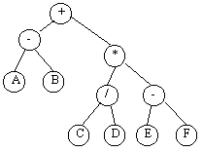
Depth First Tree Traversal Example
Operands in leaves
Operators in non-leaf nodes
LNR:
(A-B)+((C/D)*(E-F))
NLR:
+-AB*/CD-EF
LRN:
AB-CD/EF-*+

Slide 18
Implementations
template <class T>
void InOrder(TreeNode<T>*t)
{
if(t!=NULL)
{
InOrder(t->Left())
cout<<t->data()//do what you will do when you visit the node
InOrder(t->Right())
}
}
template <class T>
void PreOrder(TreeNode<T>*t)
{
if(t!=NULL)
{
cout<<t->data()//do what you will do when you visit the node
PreOrder(t->Left())
PreOrder(t->Right())
}
}
template <class T>
void PostOrder(TreeNode<T>*t)
{
if(t!=NULL)
{
PostOrder(t->Left())
PostOrder(t->Right())
cout<<t->data()//do what you will do when you visit the node
}
}

Slide 19
Example
Count the leaves of a binary tree
Use Post-order traversal (LRN)
Idea:
Keep a count variable
Increment at each visit when ıt ıs a leaf node
Problem:
Each visit is a separate recursive call.
How to pass and modify the count variable between functions?

Slide 20
Example
template <class T>
void CountLeaf(TreeNode<T> *t, int& count)
{
if (t!=NULL)
{//using postorder traversal
CountLeaf(t->Left(),count);
CountLeaf(t->Right(),count);
//visiting a node means incrementing if leaf
if (t->Left()==NULL&&t->Right()==NULL)
count++;
}
}
PASS BY REFERENCE:
To pass and modify information
among recursive calls

Slide 21
Example
Find the depth of a binary tree
Idea:
Recursively descend to the leaves (depth =0 at the leaves)
As you come back up to root increment depth
Pass information with a return value from function

Slide 22
Example
template <class T>
int Depth(TreeNode<T> *t)
{int depthleft, depthRight, depthval;
if (t==NULL)
depthval=-1; // if empty, depth=-1
else
{depthLeft=Depth(t->left());
depthRight=Depth(t->Right());
depthval=1+(depthleft>depthRight?depthLeft:depthRight));
}
return depthval;
}
if(depthleft>depthRight)
depthLeft
else
depthRight
CONDITION? True-case-EXP:False-case-EXP

Slide 23
Examples
Find the level of the leaf node at the minimum level
template <class T>
int minLeafdepth(TreeNode<t>* t)
{}
Find the minimum key value stored in a binary tree pointed by t
template <class T>
int minval(TreeNode<t>* t)
{}

Slide 24
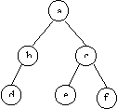
Breadth First
Scan level by level: visit all nodes at the same level, then descend next level
Iterative algorithm:
A queue to hold the items
Algorithm Level-Traverse
1. Insert root node in queue
2. While queue is not empty
2.1. Remove front node from queue and visit it
2.2. Insert Left child
2.3. Insert right child
Traversal sequence a,b,c,d,e,f

Slide 25
Breadth First
// traverse the list by level by level and visit each node
template <class T>
void LevelScan(TreeNode<T> *t, void visit(T& item))
{
// store siblings of each node in a queue so that they are
// visited in order at the next level of the tree
Queue<TreeNode<T> *> Q;
TreeNode<T> *p;//temporary variable
// initialize the queue by inserting the root in the queue
Q.QInsert(t);
// continue the iterative process until the queue is empty
while(!Q.QEmpty())
{
// delete front node from queue and execute visit function
p = Q.QDelete();
cout<<p->data()//do what you will do when you visit the node
// if a left child exists, insert it in the queue
if(p->Left() != NULL)
Q.QInsert(p->Left());
// if a right child exists, insert next to its sibling
if(p->Right() != NULL)
Q.QInsert(p->Right());
}
}

Slide 26
Binary Search Tree
A BST is a BT in which data values in the left subtree of every node are “less than” the data value in the node and those in the right subtree are “greater”.
e.g.
NOTE: Inorder traversal (LNR) generates ascending sequence
80
210
25
A BST is a two-way search tree
305
67
91
92
26

Slide 27

M-way Search Tree
Definition: An m_way search tree is a tree in which all nodes are of degree<=m. (It may be empty). A non empty m_way search tree has the following properties:
a) It has nodes of type:
b) key1 < key2 <...< key(m-1)
in other words, key_{i}<key_{(i+1)}, 1<=i<m-1
c) All Key values in subtree Ti are greater than Key_{i-1} and less than Key_{i}

Slide 28
3-way Search Tree

Slide 29
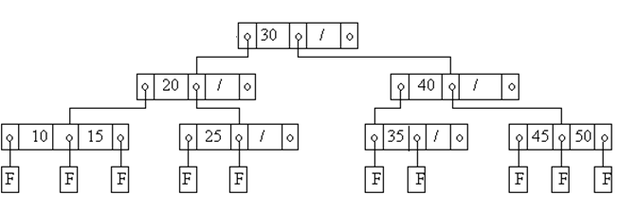
M-way Search Tree
Failure nodes are the nodes where an unsuccessful search terminates
For all keys stored:
There are non-empty subtrees at the right and left of the key
OR
A failure node in place of an empty subtree

Slide 30
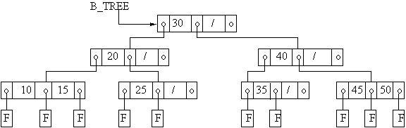
(Balanced) B-Trees
A B-tree of order m is an m-way search tree (possibly empty) satisfying the following properties (if it is not empty)
All nodes other than the root node and leaf nodes have at least, children
The tree is balanced➔ Any failure in any search must always end at the same level
All the leaf nodes are at the same level
All (failure) nodes are at the same level

Slide 31
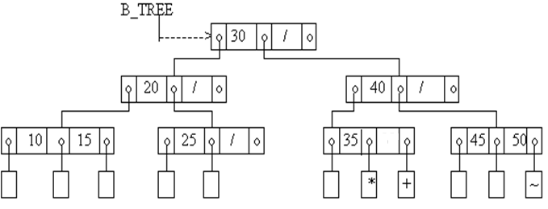
Inserting Nodes
We want to insert a new key value into a B-tree:
The resulting tree must also be a B-tree. (It must be balanced.)
We'll always insert at the leaf nodes.
Example1: Insert 38 to the B_tree

Slide 32
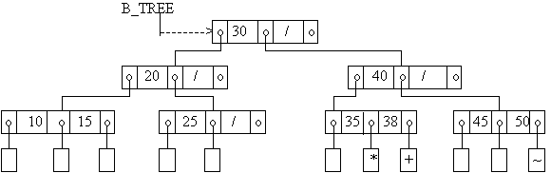
Inserting Nodes: Example 1
Insert 38 to the B_tree
Search for 38 in the given b_tree. It is an unsuccessful search.
We hit the failure node marked with "*" .
The parent of that failure node has only one key value so it has space for another one.
Insert 38 there , add a new failure node, which is marked as "+" in the following figure, and return.

Slide 33
Inserting Nodes: Example 2
Example2: Now, insert 55 to this B_tree.
We do the search and hit the failure node "~".
However, it's parent node does not have any space for a key value.
We create temporarily a new node with m key values and insert 55 in this new node

Slide 34
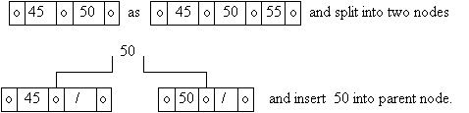
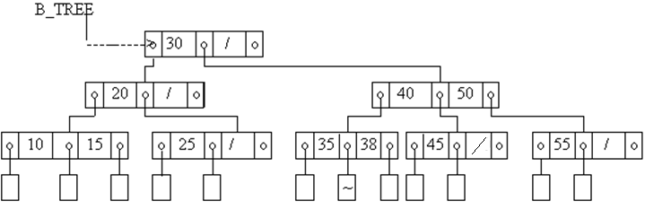
Inserting Nodes: Example 2
We then split this temporary node and move the center element out and insert it into its parent node
Final B-Tree

Slide 35
Inserting Nodes: Example 3
Insert 37
We search for 37, and hit a failure node between 35 and 38.

Slide 36

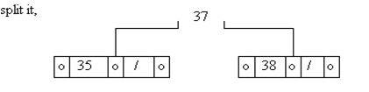
Inserting Nodes: Example 3

Slide 37


Inserting Nodes: Example 3

Slide 38
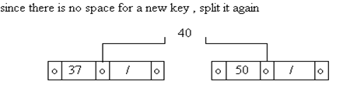
Inserting Nodes: Example 3

Slide 39
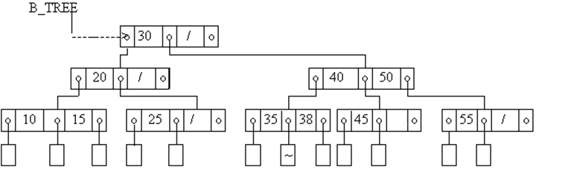
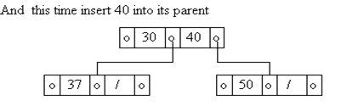

Inserting Nodes: Example 3

Slide 40
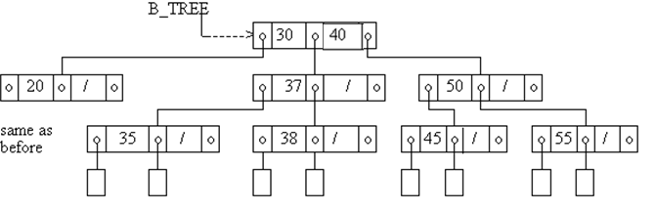
Inserting Nodes: Example 3
Before Insertion:
Depth=2
After Insertion :
Depth=2

Slide 41
B-Trees
The depth of the B-Tree increases very slowly
Search time increases with depth in m-way search trees➔Fast search time
When does the depth of a B-Tree increment?
When we split the root node
Example: Insert 34, 32, and 33

Slide 42
EE 441 Data Structures
Lecture 8: Trees

